Slide 1
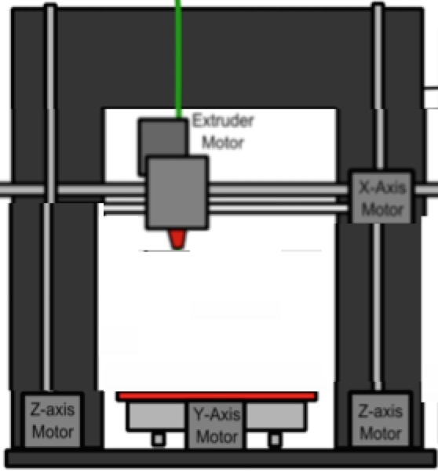
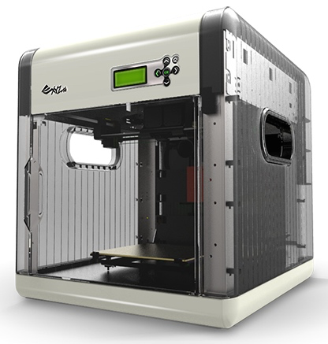
3D Printing Business Venture!
Slide 0
Learning Game Assessment
By Ammon Smith

Slide 2
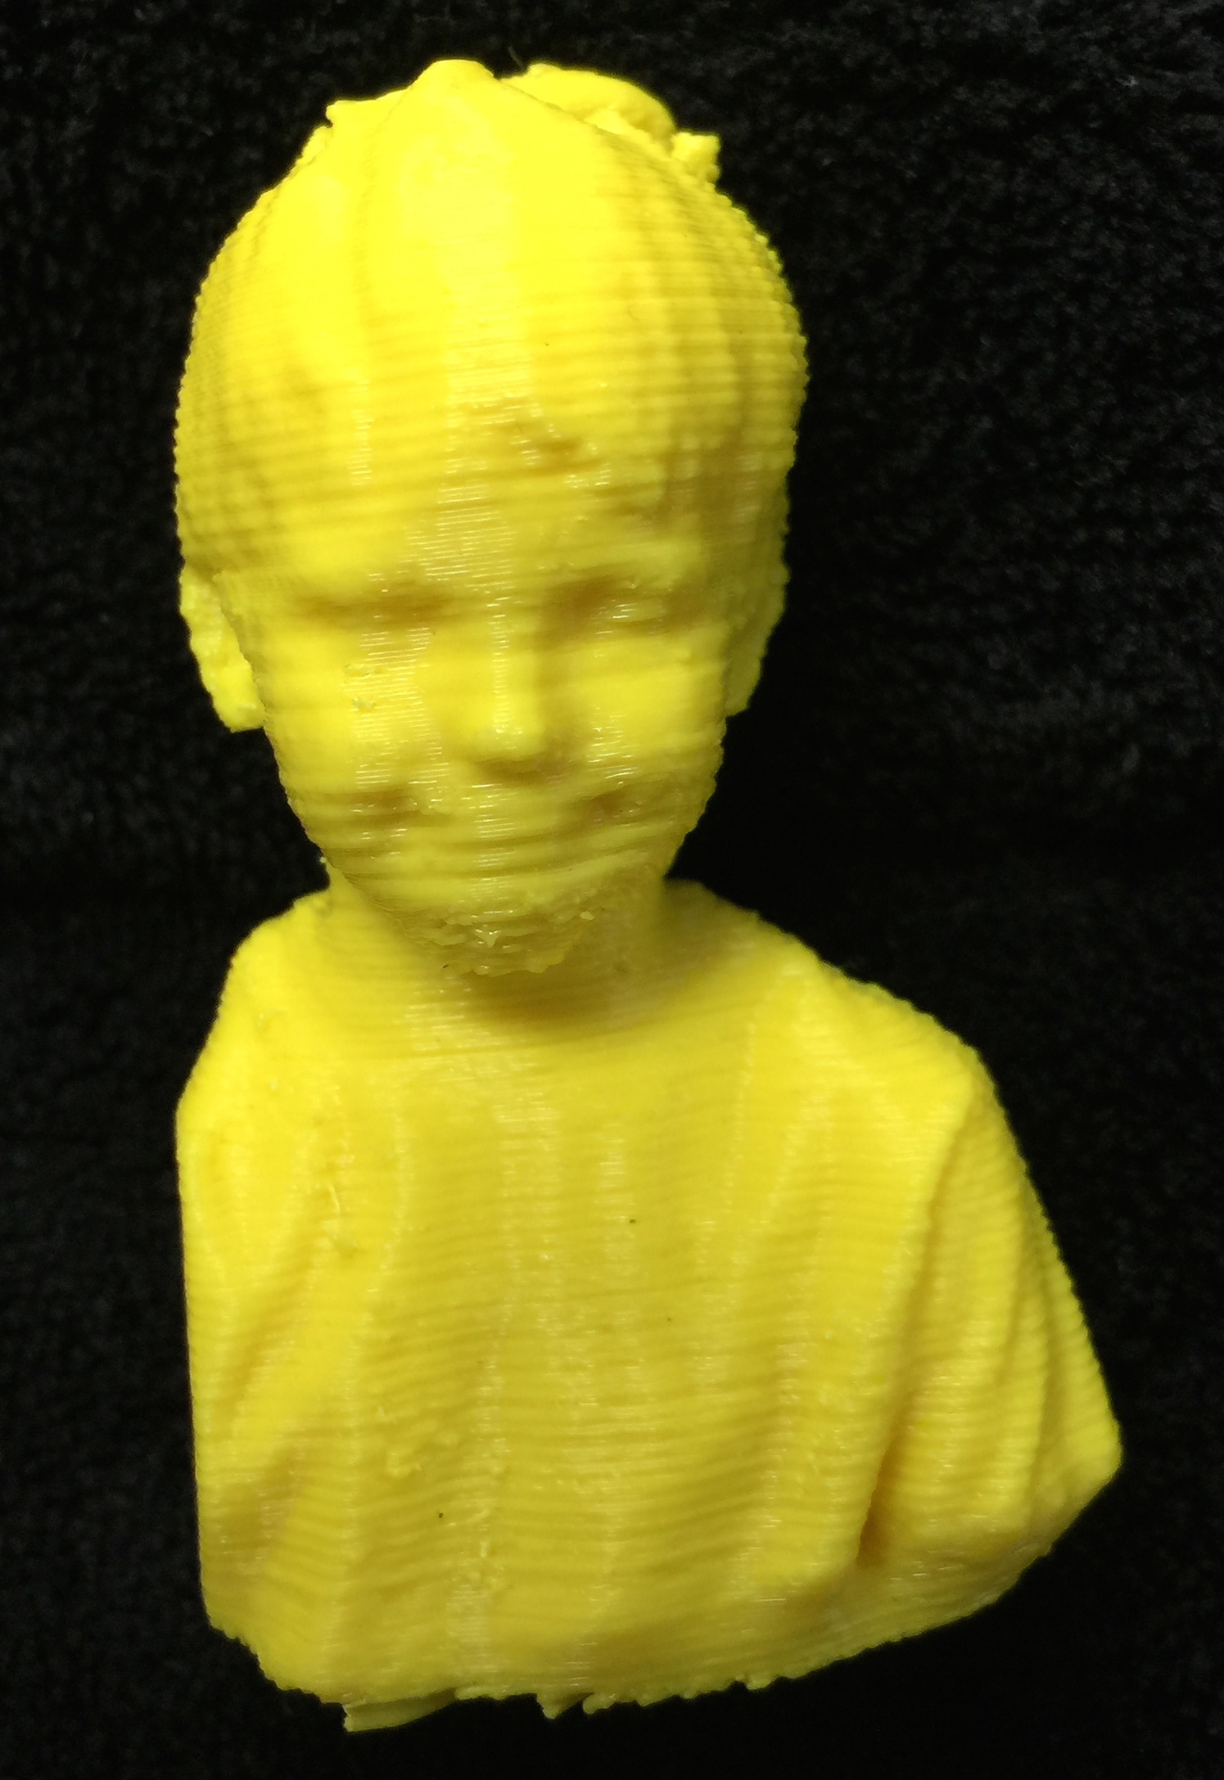
True or false, The Da Vinci 1.0 is the best 3D printer to use for printing a titanium bone replacement?
Slide 1
Narration Audio - Drag the 3D Printed object on the right into the correct box on left. Select the next icon to submit your answer.
True -
False -
Exit Exam Early
Notes:
Narration Audio can be repeated by the learner when they select the audio icon at the top.

Slide 3
True or false, The Da Vinci is the best 3D printer to use for printing a titanium bone replacement?
Slide 1
Narration Audio – Sorry the Da Vinci is not able to print in Titanium. Select the Inquire button at the top if you would like to return to the module for additional review!
True -
False -
Exit Exam Early

Slide 4
True or false, The Objet M1000 is the best 3D printer to use for printing a titanium bone replacement?
Slide 1
Narration Audio – That is exactly right! The Da Vinci 1.0 can only print plastic objects, however the EOSINT M280 can print objects directly into titanium! Click the next icon to continue.
Correct!
True -
Sound Effect (CHA CHING!)
False -

Slide 5
True or false, The Da Vinci 1.0 has the same printing resolution of the popular Makerbot 3D printer at 100 microns.
Slide 2
Narration Audio - Drag the 3D Printed object on the right into the correct box on left. Select the next icon to submit your answer!
True -
False -
Exit Exam Early
Notes:
The 3D printed object is my Son!

Slide 6
True or false, The Da Vinci 1.0 has the same printing resolution of the popular Makerbot 3D printer at 100 microns.
Slide 2
Narration Audio – Hrmnn…. Not so much. One of the great benefits of the Da Vinci 1.0 is that it does print at the same resolution as the Makerbot. Select the Inquiry button for addition review.
True -
False -
Exit Exam Early

Slide 7
True or false, The Da Vinci 1.0 has the same printing resolution of the popular Makerbot 3D printer at 100 microns.
Slide 2
Narration Audio – That is exactly right! One of the most fantastic things about this is that the Da Vinci 1.0 is also 1/4th the cost of the Makerbot! Select the next icon to continue.
Correct!
True -
Sound Effect (CHA CHING!)
False -

Slide 8
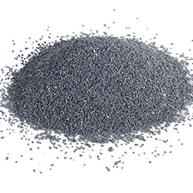
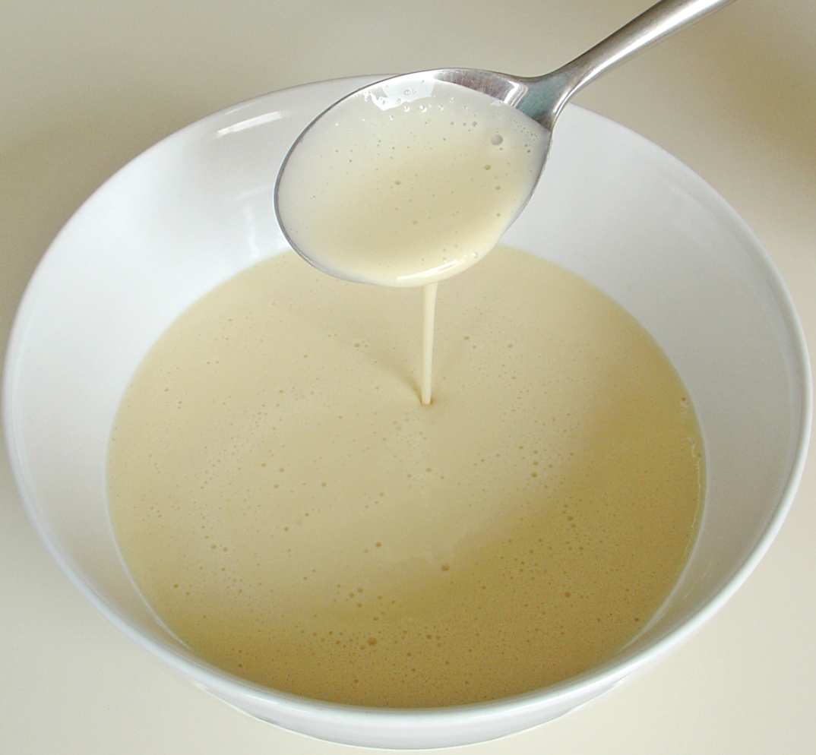
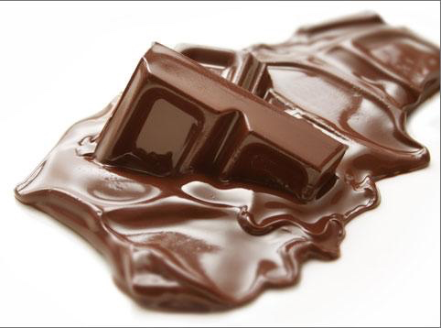
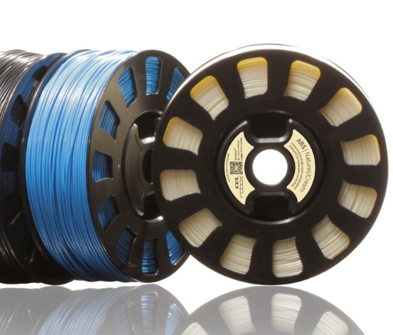
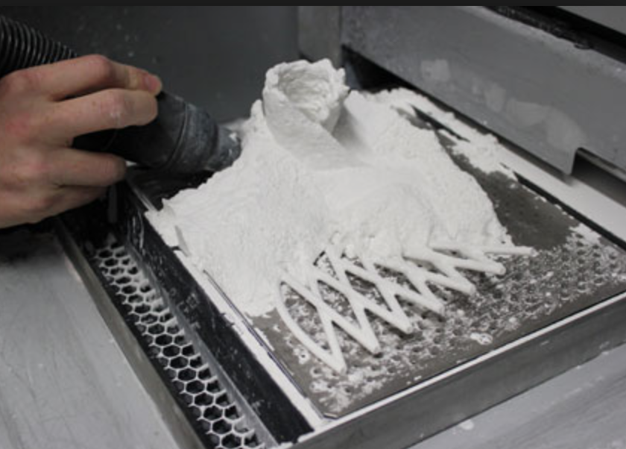
What kind of filament is used by the Imagine 3D printer?
Slide 3
Narrated text with Audio – Drag the correct image of Filament onto the left into the 3D printer image on the right to submit your answer!
Pancake Batter
Titanium
Chocolate
Plastic Spool
Plastic Powder
Exit Exam Early
Notes:
Note to Instructor – The chocolate and Pancake batter are in fact valid alternatives discussed in my module. Food 3D printed products are on the rise. Filament is the building material used to create the 3D printed object.

Slide 9
What kind of filament is used by the Imagine 3D printer?
Slide 3
Narrated text with Audio- Hrmn… not so much. As great at the Imagine 3D printer is, it does not print pancakes. Select the inquiry button to review if needed!!
Pancake Batter
Titanium
Chocolate
Plastic Spool
Plastic Powder
Exit Exam Early
Notes:
Note to Instructor – The chocolate and Pancake batter are in fact valid alternatives discussed in my module. Food 3D printed products are on the rise. Filament is the building material used to create the 3D printed object.

Slide 10
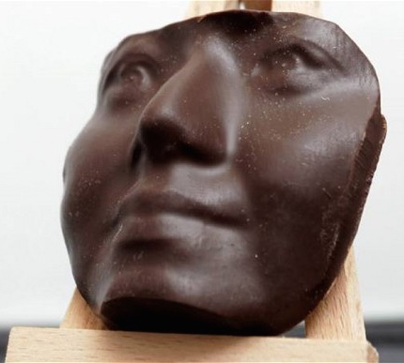
What kind of filament is used by the Imagine 3D printer?
Slide 3
Narrated text with Audio – Yummy!!! That is exactly right! Enjoy a 3D printed chocolate face and select the next button to continue!
Correct!
Sound Effect (CHA CHING!)
Pancake Batter
Titanium
Chocolate
Plastic Spool
Plastic Powder
Exit Exam Early
Notes:
Note to Instructor – The chocolate and Pancake batter are in fact valid alternatives discussed in my module. Food 3D printed products are on the rise. Filament is the building material used to create the 3D printed object.

Slide 11
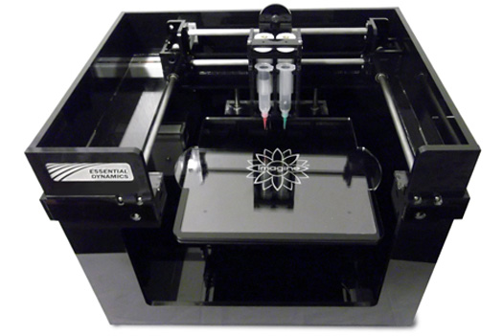
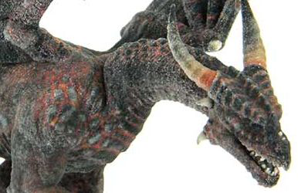
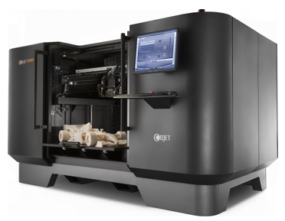
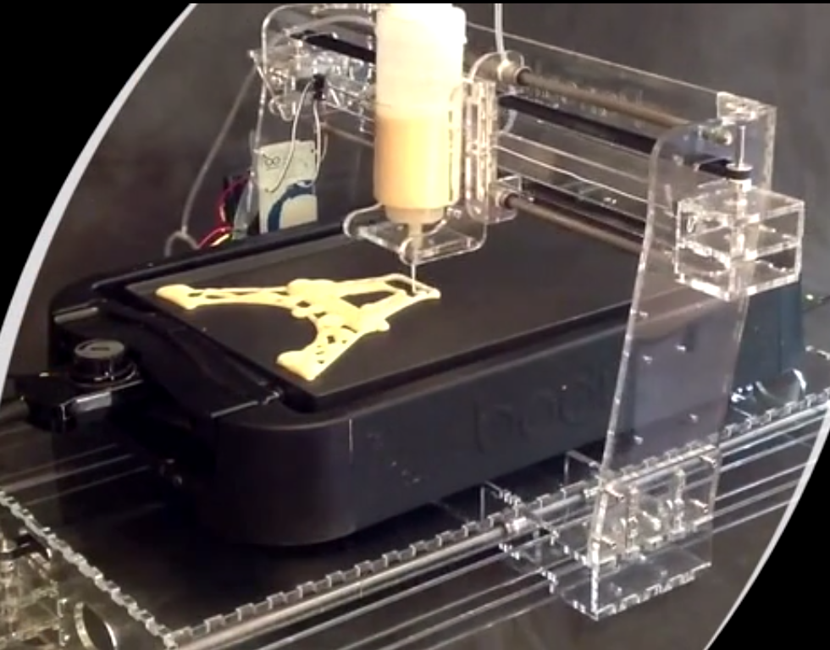
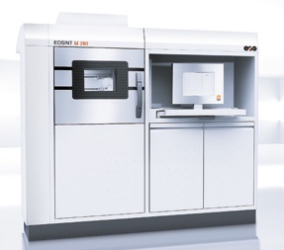
A solid 4 foot long dragon of any material would need to be printed on what type of 3D printer?
Slide 4
Narrated text with Audio – Drag the 3D printed dragon onto the image of the correct printer on the right with a build volume large enough to make your dragon in a single print to submit your answer!
Imagine 3D
Da Vinci 1.0
Objet M1000
Pancake Bot
EOSINT M 280
Exit Exam Early

Slide 12
A solid 4 foot long dragon of any material would need to be printed on what type of 3D printer?
Slide 4
Narrated text with Audio – Hrmnn… Not so much. The pancake bot makes incredible pancakes, but unfortunately none as big as 4 feet. Select the inquiry button to review!
Imagine 3D
Da Vinci 1.0
Objet M1000
Pancake Bot
EOSINT M 280
Exit Exam Early
Notes:
Note to Instructor – The chocolate and Pancake batter are in fact valid alternatives discussed in my module. Food 3D printed products are on the rise. Filament is the building material used to create the 3D printed object.

Slide 13
A solid 4 foot long dragon of any material would need to be printed on what type of 3D printer?
Slide 4
Narrated text with Audio – That is exactly right! The Objet can print solid objects up to an incredible 6 feet in size at one time. Enjoy your FANTASTIC DRAGON! Select the next arrow to continue!
Sound Effect (CHA CHING!)
Imagine 3D
Da Vinci 1.0
Correct!
Objet M1000
Pancake Bot
EOSINT M 280
Exit Exam Early
Notes:
Note to Instructor – Learner will hear some brief sound effects and small 3D print animation of the dragon being printed and awarded to them!

Slide 14
Match the correct type of filament on the left with the correct 3D printer that uses it on the right.
Slide 5
Narrated text with Audio – Drag the filament image on the left on top of the correct printer image on the right. When you have made your final selection select the next icon to submit your answer!
Pancake Batter
Da Vinci 1.0
Titanium
Chocolate
Objet M1000
Plastic Spool
EOSINT M 280
Plastic Powder
Exit Exam Early
Notes:
Note to Instructor – The chocolate and Pancake batter are in fact valid alternatives discussed in my module. Food 3D printed products are on the rise. Filament is the building material used to create the 3D printed object.
3D printer machine sound effects activated when a image is dropped onto the 3d printer.

Slide 15
Match the correct type of filament on the left with the correct 3D printer that uses it on the right.
Slide 5
Narrated text with Audio –Hrmn….Not so much. As great as the Da Vinci 1.0 is, unfortunately it can not print objects in chocolate. Select the Inquiry icon if you need to review!
Pancake Batter
Da Vinci 1.0
Titanium
Chocolate
Objet M1000
Plastic Spool
EOSINT M 280
Plastic Powder
Exit Exam Early
Notes:
Note to Instructor – The chocolate and Pancake batter are in fact valid alternatives discussed in my module. Food 3D printed products are on the rise. Filament is the building material used to create the 3D printed object.
3D printer machine sound effects activated when a image is dropped onto the 3d printer.

Slide 16
Match the correct type of filament on the left with the correct 3D printer that uses it on the right.
Slide 5
Narrated text with Audio – That is Exactly right! The Da Vinci 1.0 prints with a plastic spool while the Object uses a plastic powder, and the EOSINT prints in titanium! Select the next icon to continue!
Sound Effect (CHA CHING!)
Correct!
Pancake Batter
Da Vinci 1.0
Titanium
Chocolate
Objet M1000
Plastic Spool
EOSINT M 280
Plastic Powder
Exit Exam Early
Notes:
Note to Instructor – The chocolate and Pancake batter are in fact valid alternatives discussed in my module. Food 3D printed products are on the rise. Filament is the building material used to create the 3D printed object.
3D printer machine sound effects activated when a image is dropped onto the 3d printer.

Slide 17
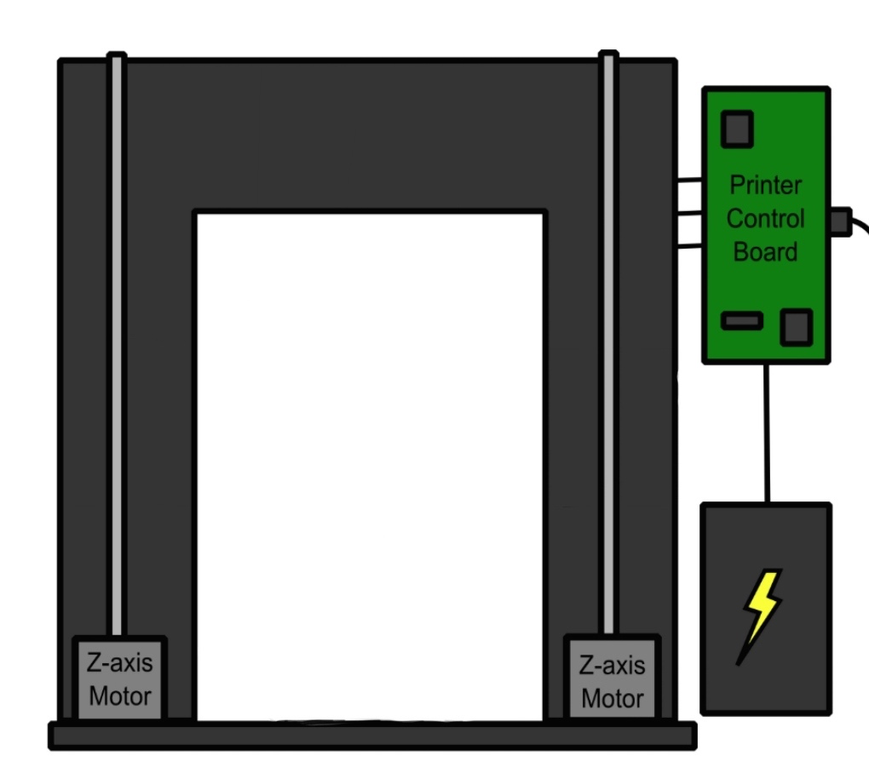
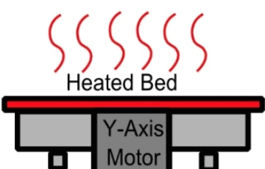
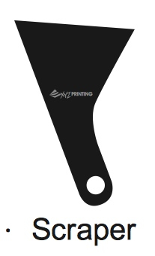
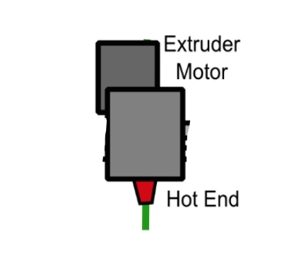
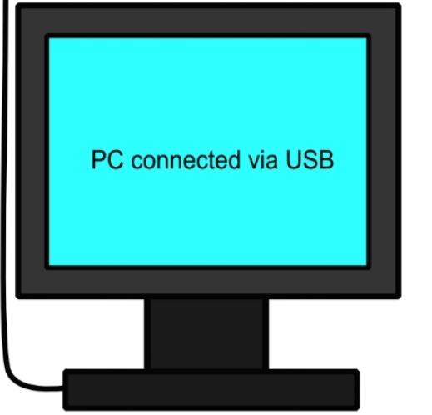
Match the correct parts of a 3d printer from the left side of the screen and insert them into their proper place on the diagram to the right.
Slide 6
Narrated text with Audio – Lets make a 3D printer! Build the printer by inserting the parts on the left into the printer on the right. When you have made your final selection select the next icon to submit your answer!
Scraper
Heated Bed
Extruder Head
Computer
Mechanical Arm
Exit Exam Early
Notes:
Note to Instructor - 3D printer machine sound effects activated when parts are dropped into the 3d printer

Slide 18
Match the correct parts of a 3d printer from the left side of the screen and insert them into their proper place on the diagram to the right.
Slide 6
Narrated text with Audio – Hrmn…While scrapers are important they are not an essential part of a 3D printer, and they don’t work on a mechanical arm…. Select the inquiry icon to review.
Scraper
Heated Bed
Extruder Head
Computer
Mechanical Arm
Exit Exam Early
Notes:
Note to Instructor - 3D printer machine sound effects activated when parts are dropped into the 3d printer

Slide 19
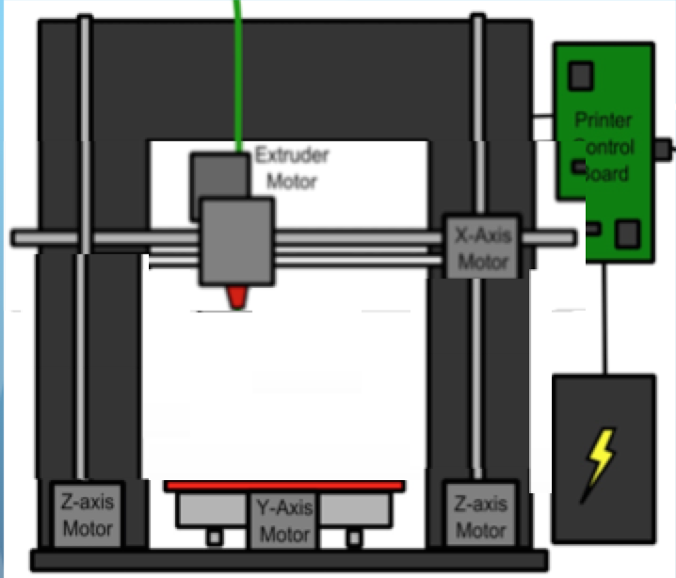
Match the correct parts of a 3d printer from the left side of the screen and insert them into their proper place on the diagram to the right.
Slide 6
Narrated text with Audio – Outstanding!!!! That is exactly right! I would have you build anything for me any day! Here is a 10% coupon for printer repair services at microcenter if you ever need it! Select the next icon to continue!
Congratulations, you just got a 10% OFF coupon to Microcenter for printer repairs!
Sound Effect (CHA CHING!)
10% OFF!
Scraper
Heated Bed
Extruder Head
Computer
Mechanical Arm
Exit Exam Early
Notes:
Note to Instructor - 3D printer machine sound effects activated when parts are dropped into the 3d printer

Slide 20
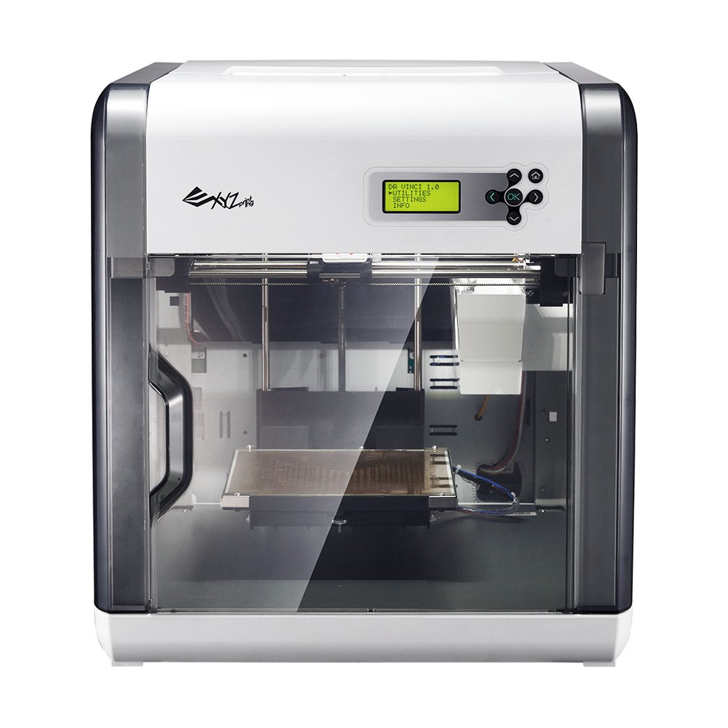
The Da Vinci 1.0 stores filament inside a plastic ____________.
Slide 7
Narrated text with Audio –This was discussed clearly in the learning module and is important to understand to ensure you purchase the right kind of filament. Fill in your answer on the line below and select the next icon to submit your answer!
_____________________________.
Exit Exam Early
Notes:
Note to Instructor – The chocolate and Pancake batter are in fact valid alternatives discussed in my module. Food 3D printed products are on the rise. Filament is the building material used to create the 3D printed object.
3D printer machine sound effects activated when a image is dropped onto the 3d printer.

Slide 21
The Da Vinci 1.0 uses a type of filament made of____________.
Slide 7
Narrated text with Audio –Hrmn… Not so much. As great as the Da Vinci 1.0 is, it can not print objects in titanium. Select the inquiry button to review if needed.
titanium
_____________________________.
Exit Exam Early
Notes:
Note to Instructor – The chocolate and Pancake batter are in fact valid alternatives discussed in my module. Food 3D printed products are on the rise. Filament is the building material used to create the 3D printed object.
3D printer machine sound effects activated when a image is dropped onto the 3d printer.

Slide 22
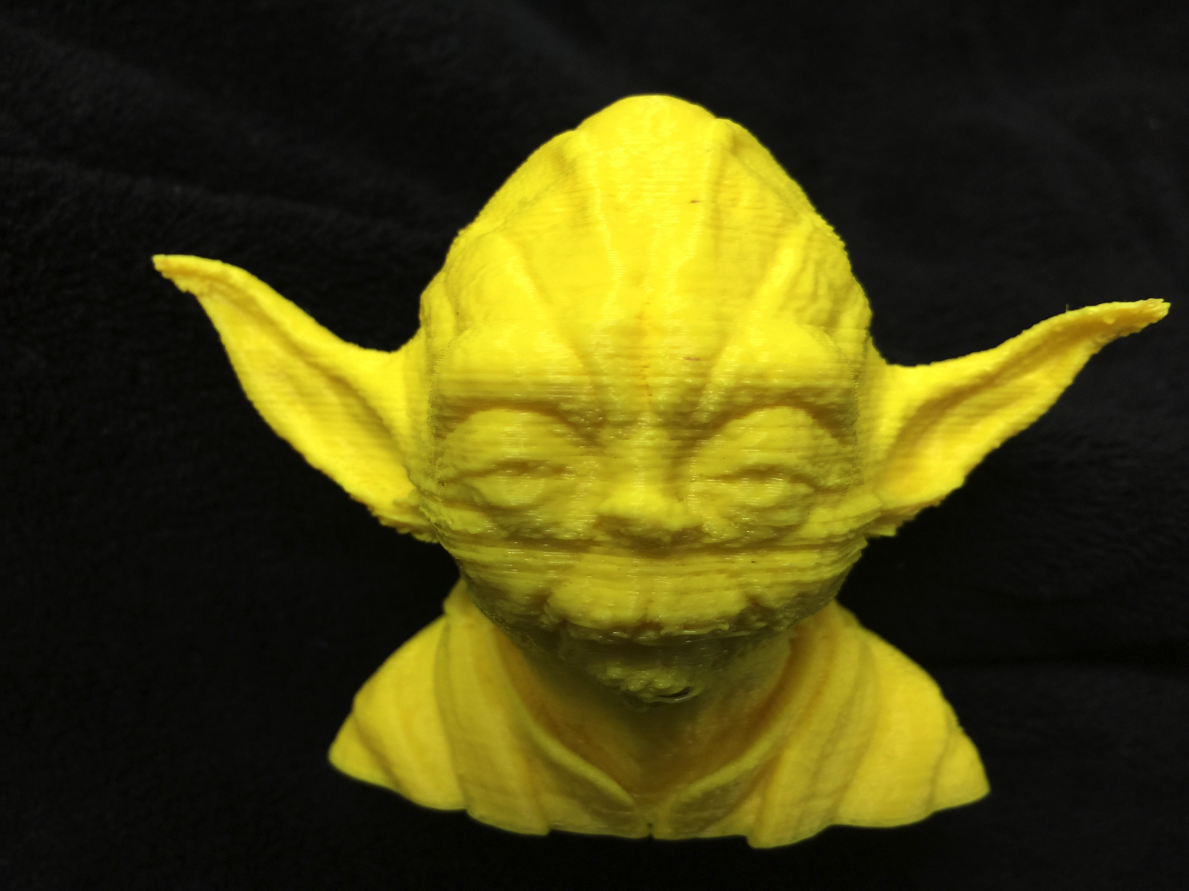
The Da Vinci 1.0 uses a type of filament made of____________.
Slide 7
Narrated text with Audio –Amazing! Someone was paying attention. You are exactly right! The Da Vinci 1.0 prints amazing pieces in plastic. Enjoy this nifty 3D printed Yoda made on the Da Vinci 1.0! Select the next icon to continue!
Correct!
plastic
_____________________________.
Exit Exam Early

Slide 23
The Imagine 3D printer ejects its chocolate filament while printing to build an object through the extruder ___________.
Slide 8
Narrated text with Audio –This was discussed clearly in the learning module and is important to understand how 3D printers work. Fill in your answer on the line below and select the next icon to submit your answer!
__________________
Exit Exam Early

Slide 24
The Imagine 3D printer ejects its chocolate filament while printing to build an object through the extruder ___________.
Slide 8
Narrated text with Audio –Hrmn.. Not so much. Select the Inquiry icon to review the diagram of 3D printer parts!
Tube
___________________
Exit Exam Early

Slide 25
The Imagine 3D printer ejects its chocolate filament while printing to build an object through the extruder _________.
Slide 8
Narrated text with Audio –Incredible! You have a fantastic memory and are learning well. Client Bob would definitely be pleased! Here is a special thank you from Bob! You will also notice your 3D printed object at the top is not complete and you are now CEO! Select the home button to return to the main menu!
Correct!
Sound Effect (CHA CHING!)
Head
__________________
Exit Exam Early
Notes:
Instructor Notes – Gotta Love Client Bob!

