Slide 1
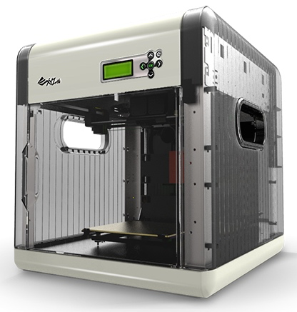
3D Printing Business Venture!
The Adventure Game
by Ammon Smith
For Artists & Business Professionals

Slide 2
Game Platform
Smart Phones
Tablets
Laptops
Desktops
Touch Screen compatible

Slide 3
Game Concept
Learners are an artist/business professional that is in popular demand due to their skills and creativity. 3D Printing Business Venture is all about putting those skills to work by using their knowledge of 3D printing to meet the needs of clients in a quest game format.

Slide 4
Concept Continued
3D Printing is a new emerging technology that a lot of art students and business professionals do not yet have a lot of real world experience using. This game helps learners secretly continue their learning about 3D printers and seeing how their differences are important in real world business scenarios.
Learners need to understand the differences in the kinds of 3D printers available; this game will help them to do this in a fun and engaging way with real rewards.
Learners will progress through the game in the form of an adventure game appropriate for my target audience of students and business professionals. Difficulty for each client would vary or increase as learners progress and level up in the form of promotions. Learners would also receive animated comical feedback based on their choices from the clients.

Slide 5
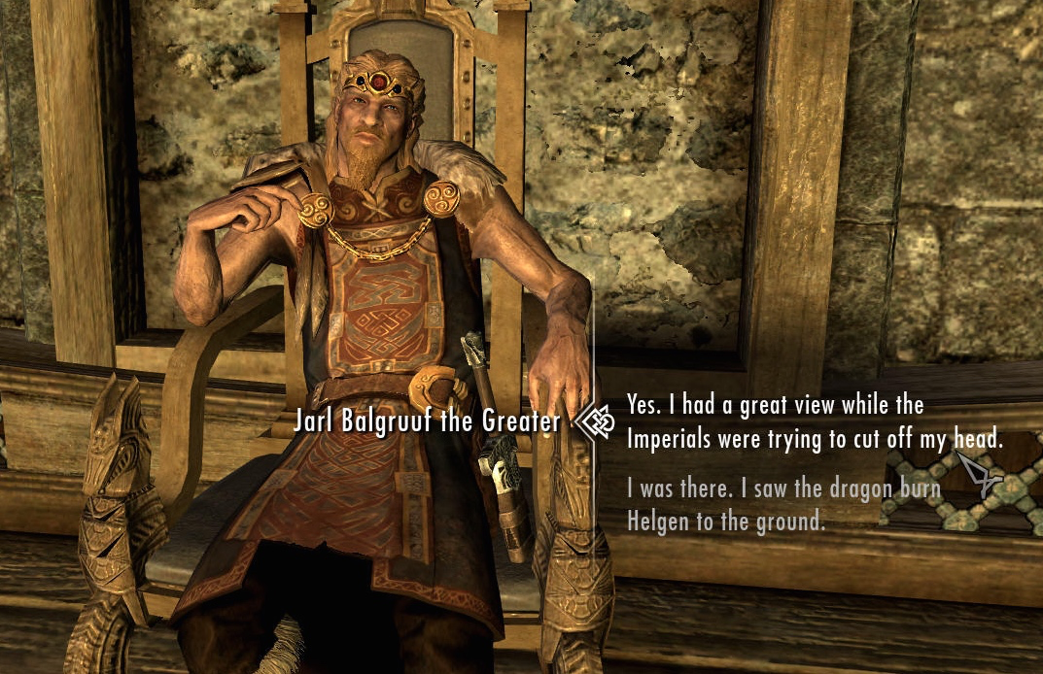
Game Inspiration
3D Printing Business Venture is based on quest games where players are given response selections to choose from when encountering new characters like the game Skyrim pictured below. Players will be rewarded based on the appropriateness of their responses.

Slide 6
Secret Selling
The secret selling that is taking place in this game is creating an environment where students are continuing to learn about 3D printers, applying what they have learned from the main body of the training module, and learning how the differences in the kinds of 3D printers available apply in real work scenarios while being engaged in the game.
Students will continue to learn through responses from clients in the game without consciously acknowledging the lessons about 3D printers and their important differences.
Learners will gain an appreciation while having fun enjoying their progression in the game and seeing client responses.

Slide 7
Game Goal
The goal of 3D Printing Business Venture is for players to correctly choose the appropriate kind of 3D printer required to complete the needs of various clients.
Each client will have their own demands with unique needs. Learners will gain experience with real business scenarios.
After having completed a portion of the Module on the kinds of 3D printers available learners will go on a quest game where they will be challenged by clients that have specific demands on what they want, and then learners will select the appropriate printer required for the task.

Slide 8
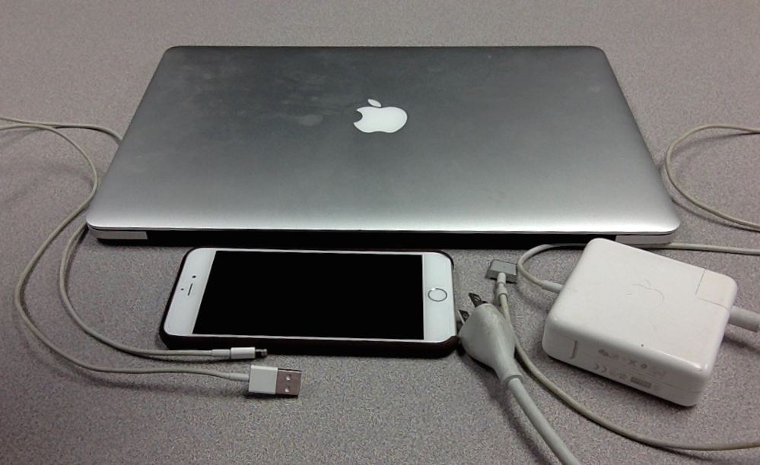
Causes for Learner Engagement
Learners will be engaged for a variety of factors including:
A fun learning environment
Animated characters and client reactions
A game theme focused on an area of learner interest
Rewards as learners progress and make correct answer selections tied to social media.
Real rewards awarded in the form of coupons for 3D printer related equipment.
Level and rank progression
Users will be able to interact in the game through a large number of devices they are comfortable using.

Slide 9
Game Mechanics
Learners will progress in the form of level based quest game.
Learners can interact with the game using a touchscreen display.
Learners will be challenged to apply what they know when given a task from a client with a realistic request.
Learners will have access to a help link to review different printer specs if needed.
Learners will increase in rank based on accurate responses and be awarded both real rewards in the form of coupons, and character promotion within the game.
Progress and awards will be posted to social media sites.
Learners will progress through the game and level up based on the accuracy of their printer selection to meet client needs.

Slide 10
Ranking System
As learners progress they will level up and be rewarded with a promotion with the image and positions outlined below. CEO is the highest rank they can achieve.
Agent
Case Manager
Manager
General Manager
CEO

Slide 11
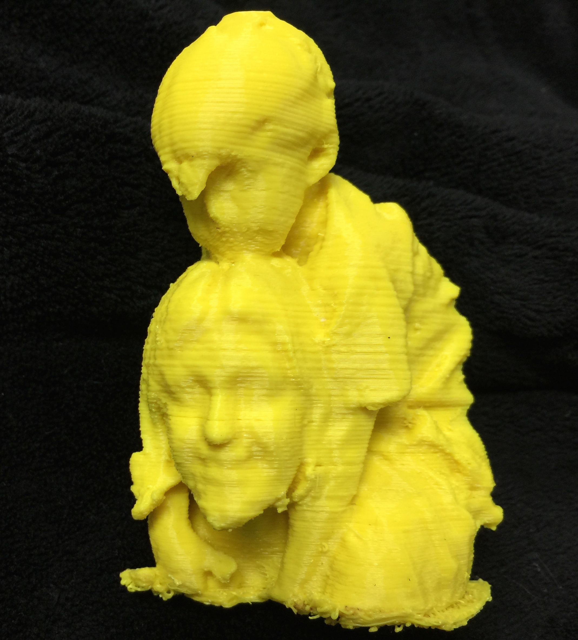
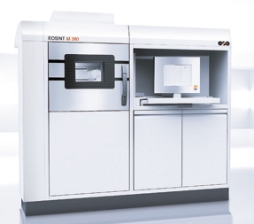
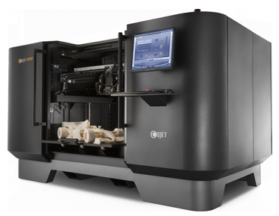
Level Layout
Each level will appear as shown below where the learner can then select their printer selection by hand or with a mouse at the bottom of the screen.
Client Bob
I want a dragon so detailed you can see the scales, and be at least 12 inches long! Can you do that?

Slide 12
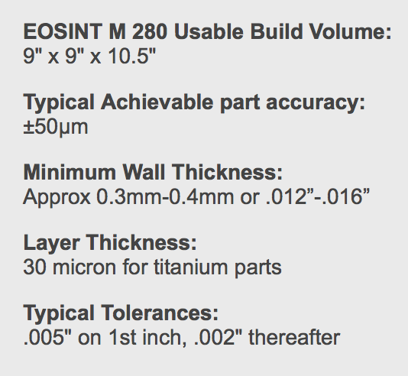
Help Aid
As learners interact with the clients and struggle to remember the printer specification covered in the module, they can select the image of the printed object in the top left corner for a spec review of each printer. Below is the image for the help link and an example of the specs they could review on one of the printers.

Slide 13
Client Reaction Example
As learners interact with the clients on different levels they will get a variety of different responses helping them gage their success. Below is an example of a client response.
This is INCRIDBLE! This Dragon is amazing! EXACTLY what I wanted. Here is a Bonus!

Slide 14
Rewards Explained
As learners progress they they will be given small rewards on their way to increasing in rank from an agent to CEO for each correct answer. Learners will move up in rank after making the best printer selection to complete the task demanded of a client 3 times in a row. If a mistake is made the learner will then have to answer 5 client demands correctly in a row before they can move up in rank.
Each Rank progression, or coupon unlocked will be posted to social media sites registered by the user.

Slide 15
Rewards Example
Below is an example of a reward that would appear for each correct response by learners with feedback.
Congratulations, Bob is so pleased you just got a 10% OFF coupon to Microcenter on plastic filament!
This is INCRIDBLE! This Dragon is amazing! EXACTLY what I wanted. Here is a Bonus!
Client Bob
10% OFF!
Share on Facebook Now!

Slide 16
Rank Advancement Example
Below is an example of a rank advancement achieved by correctly responding to client needs 3 times consecutively.
Congratulations! You have been promoted to Manager due to you excellent knowledge of 3D Printers and service to clients!
This is INCRIDBLE! This Dragon is amazing! EXACTLY what I wanted. Here is a Bonus!
Client Bob
Promotion!
Share on Facebook Now!

Slide 17
Sources:
Clip Art. Retrieved on March 07, 2015 from https://www.google.com/url?sa=i&rct=j&q=&esrc=s&source=images&cd=&cad=rja&uact=8&ved=0CAcQjRw&url=http%3A%2F%2Fwww.tlnt.com%2F2013%2F11%2F06%2Fwant-to-boost-retention-adopt-an-early-recognition-strategy%2F&ei=_Pn8VMHHB46jyATC94IY&bvm=bv.87611401,d.aWw&psig=AFQjCNFK1TXkszUmlNjWNRrVXdeuLA25ZQ&ust=1425951012534212
Computer tablet phone. Retrieved on March 07, 2015 from http://stuffdudeslike.com/wp-content/uploads/2015/02/computer-tablet-phone.jpg
Da-vinci 3d printer. Retrieved on March 07, 2015 from http://www.3ders.org/images/da-vinci-3d-printer-1.png
EOSINT M 280 facts. Retrieved on March 07, 2015 from http://titanium3dprinting.com
Eosint Printer Specs. Retireved on March 07, 2015 from http://ip-saas-eos-cms.s3.amazonaws.com/public/f5f99551d4458b18/27ebd3228c5c41627d9439e0e44a8336/eosint_m_280_1.jpg
Objet 3d printer. Retrieved on March 07, 2015 from http://cfnewsads.thomasnet.com/images/medium/625/625487.jpg
Skyrim Image. Retrieved on March 07, 2015 from http://www.mobygames.com/images/shots/l/531666-the-elder-scrolls-v-skyrim-windows-screenshot-dialogue-choices.jpg
Smith, A. (2015) All Game Art Drawings Created by Ammon Smith.

