Slide 1
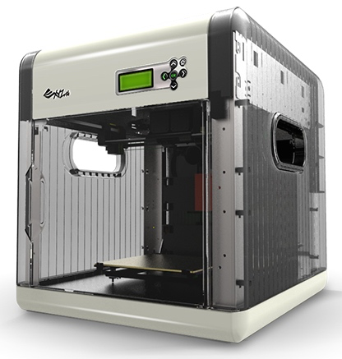
3D Printing Business Venture!
The Role Playing Game
by Ammon Smith
For New Hires in Sales, or just Great Fun!

Slide 2
Game Platform
A role playing game in a training environment where an experienced manager will be a judge to determine the level of success learners have made in making proper 3D printer related decisions.
A actor/Manager will play the part of a client with a script, and then a learner playing the game will need to make appropriate decisions based on the needs of the client.

Slide 3
Game Concept
3D Printing Business Venture Role Play is all about continuing to educate learners about 3D printers, and using that knowledge to meet the needs of clients in a role playing game format with management support in a training class environment, or with some helpful friends.
As a low tech no tech game no technical equipment is required to play this game.

Slide 4
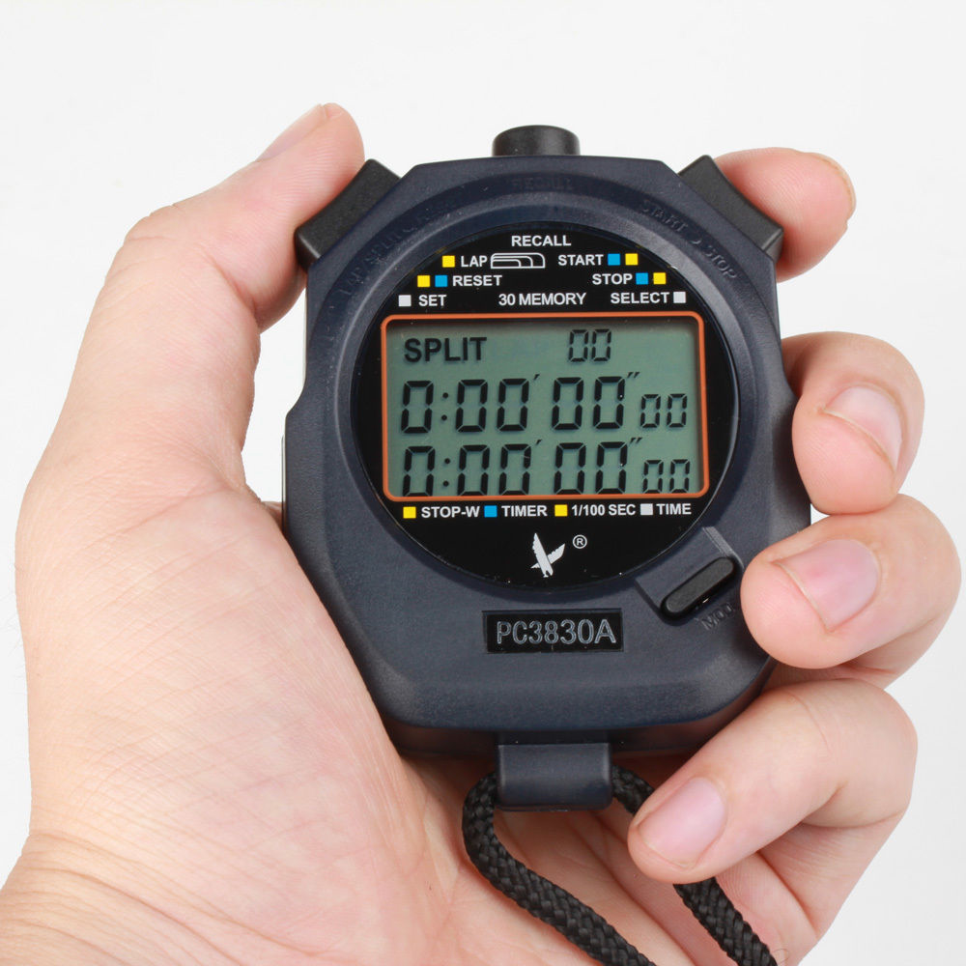
Required Equipment
Role playing question/script cards for an actor playing the roll of a client.
Stopwatch.
3D printer spec sheet aid card for the learner.
Reward print out cards for rank advancement.
Coupons/Candy for rewards.
Coupons can often be retrieved from businesses easily simply by asking.

Slide 5
Concept Continued
3D Printing is a new emerging technology that a lot of art students and business professionals do not yet have a lot of real world experience using. This game helps learners secretly continue their learning about 3D printers and seeing how their differences are important in real world business scenarios.
Learners need to understand the differences in the kinds of 3D printers available; this game will help them to do this in a fun and engaging way with real rewards with feedback from experienced workers, or helpful friends.
Learners will progress through the game in the form of a role play among upper management and other peers in training, or with friends interested in learning about 3D printing benefits. Participants in the role play game will be judged by an experienced manager, or a friend with a answer sheet and printer specs to use for verification.

Slide 6
Game Inspiration
3D Printing Business Venture Role Playing was inspired by my own training as an employee on how to deal with irate callers in a call center. We used role play to help capture the reality of the situation. 3D printing business venture has been heavily modified to add more gamification elements such as rewards a judge, and level progression.

Slide 7
Secret Selling
Although this is a low tech no tech game, secret selling is still important. The secret selling that is taking place in this game is creating an environment where students are continuing to learn about 3D printers, applying what they have learned from the main body of the training module, and learning how the differences in the kinds of 3D printers available apply in real work scenarios while being engaged in the game.
Students will continue to learn through responses from clients in the game without consciously acknowledging the lessons about 3D printers and their important differences.
Learners will gain an appreciation for 3D printers while having fun enjoying their progression in the game and interacting with management and peers.

Slide 8
Game Goal
The goal of 3D Printing Business Venture is for players to correctly choose the appropriate kind of 3D printer required to complete the needs of various clients and reach the Rank of CEO in the allotted amount of time.
Each client will have their own demands with unique needs. Learners will gain experience with real business scenarios.
After having completed a portion of the Module on the kinds of 3D printers available learners will participate in a role playing game with management staff where a manager or other trainee with a script will act the part of a client with specific needs that relate best to a specific type of 3D printer. Participants will select the appropriate printer required for the task from a list provided to them.
If a manager is not available a friend will play the role of a client and judge with an assigned script and answer sheet.

Slide 9
Causes for Learner Engagement
Learners will be engaged for a variety of factors including:
A fun learning environment interacting with management and peers in fun acting scenarios.
A fun learning environment interacting with friends if being played outside of a work environment.
A game theme focused on an area of learner interest
Rewards as learners progress and make correct answer selections.
Real rewards awarded in the form of coupons for 3D printer related equipment or nearby food locations, extra break time, preferred parking, notoriety and performance posted on a public bulletin board.
Level and rank progression
Users will be able develop a closer relationship with their peers boosting intrinsic motivation to perform well.

Slide 10
Game Mechanics
Learners will progress in the form of level based role playing game.
If learners answer 2 questions correctly consecutively they will make a Rank advancement/level advancement.
If learners answer a question incorrectly they will be given more scenarios to answer where it will be required for them to answer 2 in a row correctly before they can make a level advancement and progress.
Learners will need the assistance of at least one friend or manager to play the role of a client and judge, timekeeper, and track level progression.
Learners will be challenged to apply what they know when given a task from a client with a realistic request.
Learners will have access to a help document to review different printer specs if needed.
Learners will increase in rank based on accurate responses and be awarded both real rewards in the form of coupons, and character promotion within the game.

Slide 11
Game Mechanics Continued
Progress and award unlocks will be tracked on a dry erase board in a office training environment, or sheet of paper at a minimum.
Learners will progress through the game and level up based on the accuracy of their printer selection to meet client needs.
Printer selection will be provided to the learner on a numbered sheet of paper appropriate to the client roll play scenario question.
The game is timed with the goal being to reach the Rank of CEO in 20 minutes or less. The time starts after each scripted acted sequence ends by the client giving the learner participant a minimum of one minute to answer all scenarios correctly. Learners will struggle to make up lost time for missed questions and may not make it to CEO.
Learners completing the game and reaching the rank of CEO will receive a special reward such as preferred parking for a month, or at a minimum an even larger piece of candy.

Slide 12
Ranking System
As learners progress they will level up and be rewarded with a promotion with the image and positions outlined below. CEO is the highest rank they can achieve. With each rank advancement learners be awarded a coupon for a 3D printer related item or service. If coupons were unable to be obtained then Candy will be provided as a reward.
Agent
Case Manager
Manager
General Manager
CEO

Slide 13
Level Layout
As a role playing game the level layout will usually be in a home, office, or classroom setting. The friend playing the role of the client will also be the time keeper and progress tracker.
The actor playing the client will be at the front of the room with a stopwatch to keep time and the roll play cards in their possession.
The learner playing the sales rep will be seated in front of the actor where they are not able to see the role playing script and answer cards.
The learner/game participant will have their own answer sheet that will be changed out as needed depending on the accuracy of their answers.

Slide 14
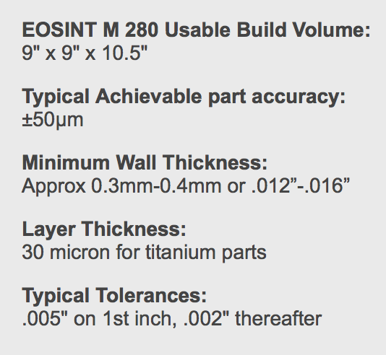
Level Layout Displayed
Help Sheet – Provided to learner if needed to reflect back on 3D printer specifications.
Manager/Friend acting – Plays the role of the client in the game, keeps track of the players time, and rank advancement on a sheet of paper or dry erase board.
Script/question Sheet – Provided to actor.
Learner– Is the player in the game striving to reach the rank of CEO to win the game as fast as possible, therefore receiving as many rewards as possible. Completion times can be compared with multiple people to create even more competition.

Slide 15
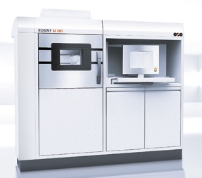
Help Aid
As a low tech no tech game, if learners struggle to remember the printer specification covered in the module they will not be able to return directly into the module, instead they will have a aid sheet that has printer specifications as pictured below. Learners will need to be careful however using this sheet because the longer they spend looking at it, the less time they will have to progress in the game.
Learners are provided a new sheet for the appropriate questions as needed.

Slide 16
Client Acted Reaction Example
As learners interact with the clients/managers or friends on different levels they will get a variety of different responses acted out helping them gage their success. This acting being portrayed by a boss or a friend can be great fun and add to the intrinsic motivation in continuing to play, and help with employee relationships.
Say WHAAAAAT! I said it needed to be detailed!
This is INCRIDBLE! This Dragon is amazing! EXACTLY what I wanted. Here is a Bonus!
Are you SERIOUS! This Dragon is Chocolate and only 7 inches long! What can I do with that! It will melt in my car!

Slide 17
Rewards Explained
As learners progress they they will be given small rewards on their way to increasing in rank from an agent to CEO for each correct answer. Learners will move up in rank after making the best printer selection to complete the task demanded of a client 2 times in a row. If a mistake is made the learner will then have to continue correctly answering the needs of a client 2 more times in a row before they can move up in rank.
Each Rank progression will have the learner move up in a fictional corporate position, and be provided a document signifying this advancement, and a coupon for a 3D printer related service, or candy at a minimum.
In a corporate environment a business may want to substitute these rewards with extra break time, or preferred parking

Slide 18
Rank Advancement/Rewards Example
Below is an example of the content on a reward letter that a learner would receive for a Rank advancement giving the learner a free 3D printed object coupon at Shapeways.
Congratulations! You have been promoted to Manager due to you excellent knowledge of 3D Printers and service to clients!
This is INCRIDBLE! This Dragon is amazing! EXACTLY what I wanted. Here is a Bonus!
Free Print!

Slide 19
Sources:
100 grand. Retrieved March 21, 2015 from http://crystal-cdn3.crystalcommerce.com/photos/861740/large/NST20660.jpg
Angry cell picture. Retrieved March 21, 2015 from http://media.mensxp.com/media/content/2013/May/1369380867_11566.jpg
Coupon. Retrieved March 21, 2015 from http://www.chicagonow.com/the-relationship-diva/files/2011/10/Coupon.jpg
Da-vinci 3d printer. Retrieved on March 07, 2015 from http://www.3ders.org/images/da-vinci-3d-printer-1.png
EOSINT M 280 facts. Retrieved on March 07, 2015 from http://titanium3dprinting.com
Eosint Printer Specs. Retireved on March 07, 2015 from http://ip-saas-eos-cms.s3.amazonaws.com/public/f5f99551d4458b18/27ebd3228c5c41627d9439e0e44a8336/eosint_m_280_1.jpg
Nerd image. Retrieved March 21, 2015 from http://d3begwarij1g0d.cloudfront.net/wp-content/uploads/2011/04/Fotolia_19526217_XS.jpg
Smith, A. (2015) All Game Art Drawings Created by Ammon Smith.
Stopwatch. Retrieved March 21, 2015 from http://i.ebayimg.com/images/i/181190724365-0-1/s-l1000.jpg
Thumbs up guy. Retrieved March 21, 2015 from http://www.godula.pl/htmlarea/uploaded/nowosci/chiptuning_instrukcja/ok.jpg
Top secret. Retrieved March 21, 2015 from http://rosannatomiuk.com/wp-content/uploads/2014/07/Top-Secret2.jpg

